Slide 1
Malignant Comments Classifier Project
Submitted by:
Gourav Kumar

Slide 2
Data Set Description
The data set contains the training set, which has approximately 1,59,000 samples and the test set which contains nearly 1,53,000 samples. All the data samples contain 8 fields which includes ‘Id’, ‘Comments’, ‘Malignant’, ‘Highly malignant’, ‘Rude’, ‘Threat’, ‘Abuse’ and ‘Loathe’.
The label can be either 0 or 1, where 0 denotes a NO while 1 denotes a YES. There are various comments which have multiple labels. The first attribute is a unique ID associated with each comment.
The data set includes:
- Malignant: It is the Label column, which includes values 0 and 1, denoting if the comment is malignant or not.
- Highly Malignant: It denotes comments that are highly malignant and hurtful.
- Rude: It denotes comments that are very rude and offensive.
- Threat: It contains indication of the comments that are giving any threat to someone.
- Abuse: It is for comments that are abusive in nature.
- Loathe: It describes the comments which are hateful and loathing in nature.
- ID: It includes unique Ids associated with each comment text given.
- Comment text: This column contains the comments extracted from various social media platforms.
This project is more about exploration, feature engineering and classification that can be done on this data. Since the data set is huge and includes many categories of comments, we can do good amount of data exploration and derive some interesting features using the comments text column available.
You need to build a model that can differentiate between comments and its categories.
Refer to the data set file provided along with this.

Slide 3
PREPROCESSING OF THE DATA
We have performed the following preprocessing on the data:
Removed punctuations
Removed the stop words
Stemming and lemmatization
Applied counter vectorizer

Slide 4
DATA MODELLING
Problem Transformation Method
We used the Multinomial Naïve Bayes classifier for classification.
We used this classifier, since it is suitable for classification with discrete features.
The algorithm estimates the conditional probability of a particular word given a class as the relative frequency of term t in documents belonging to class(c).
The variation takes into account the number of occurrences of term t in training documents from class (c),including multiple occurrences.

Slide 5
DATA MODELLING
Adaptation Algorithms
We used the Backpropagation for Multilabel Learning algorithm.
The BPMLL algorithm is a back-propagation neural network algorithm adapted for multi-label classification by having multiple binary outputs as the label variables.
It helped to classify the tweets in real-time as the algorithm changes its behavior at the time it is run, based on information available and on a priori defined criterion.

Slide 6
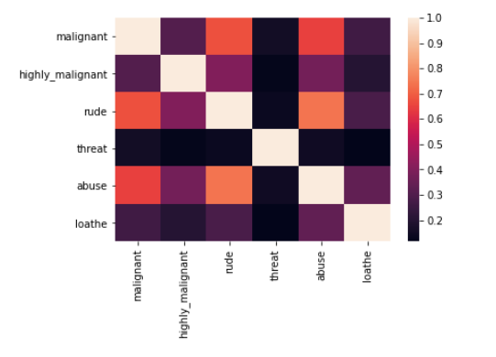
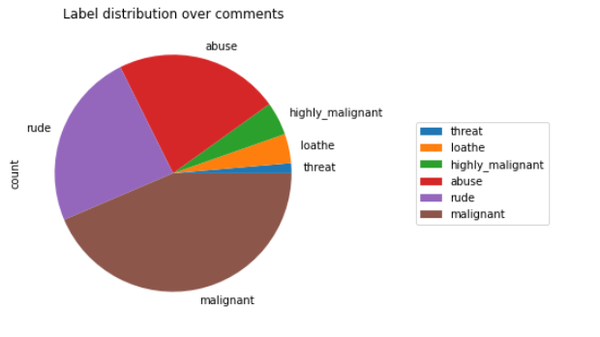
DATA VISUALIZATIONS

Slide 7
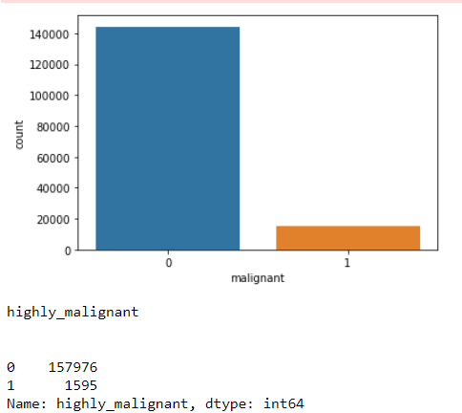
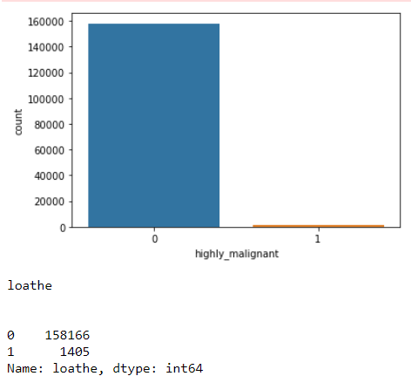
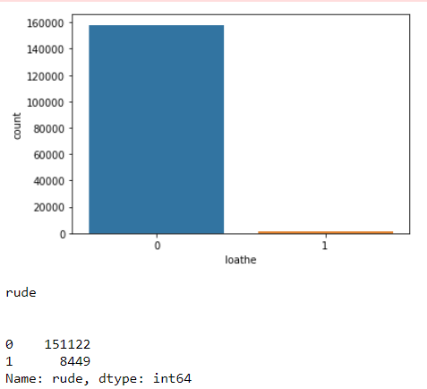
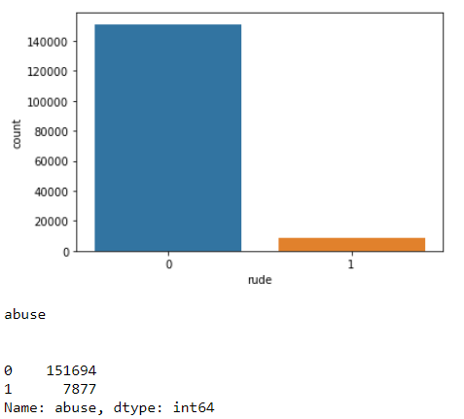
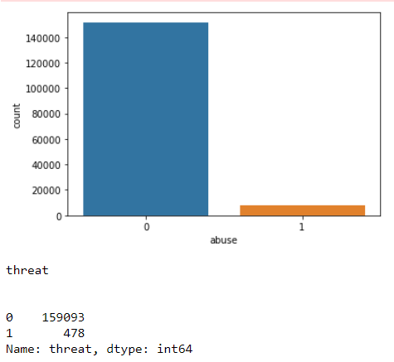
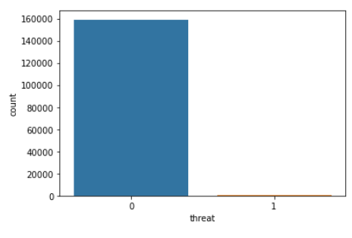
DATA VISUALIZATIONS

Slide 8
ANALYSIS OF RESULTS
Upon testing the models, on the malignant tweets we have analyzed the following:
Most of the up to 200 characters long.
Most of the fell under the “toxic” class.

Slide 9
CHALLENGES
Multiple labels – For Binary classification we have many models available but for multilabel classification the selection of models decreases drastically.
Cleaning the data – Due to the character limit tweets contain a lot of short forms which are different to classify using bag of words model.

Slide 10
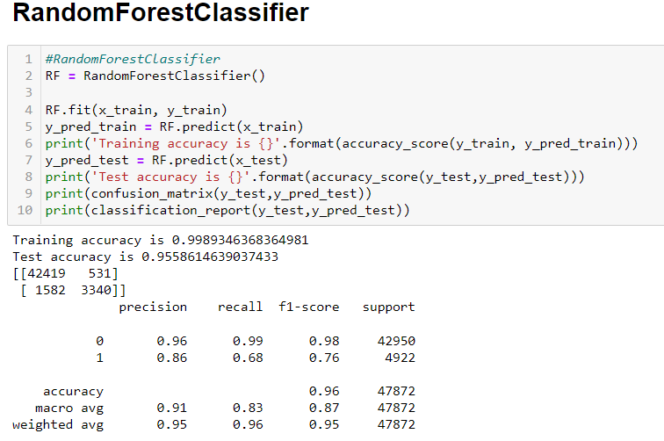
BEST MODEL
Random forest classifier
Training accuracy 99%
Test accuracy 95%
Model accuracy predict 96%

Slide 11
THANK YOU

